Slide 1
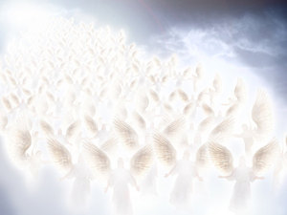
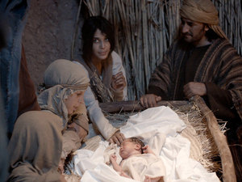
And there were shepherds living out in the fields nearby, keeping watch over their flocks at night. An angel of the Lord appeared to them, and the glory of the Lord shone around them, and they were terrified. But the angel said to them, “Do not be afraid. I bring you good news that will cause great joy for all the people. Today in the town of David a Savior has been born to you; he is the Messiah, the Lord. This will be a sign to you: You will find a baby wrapped in cloths and lying in a manger.”

Slide 2
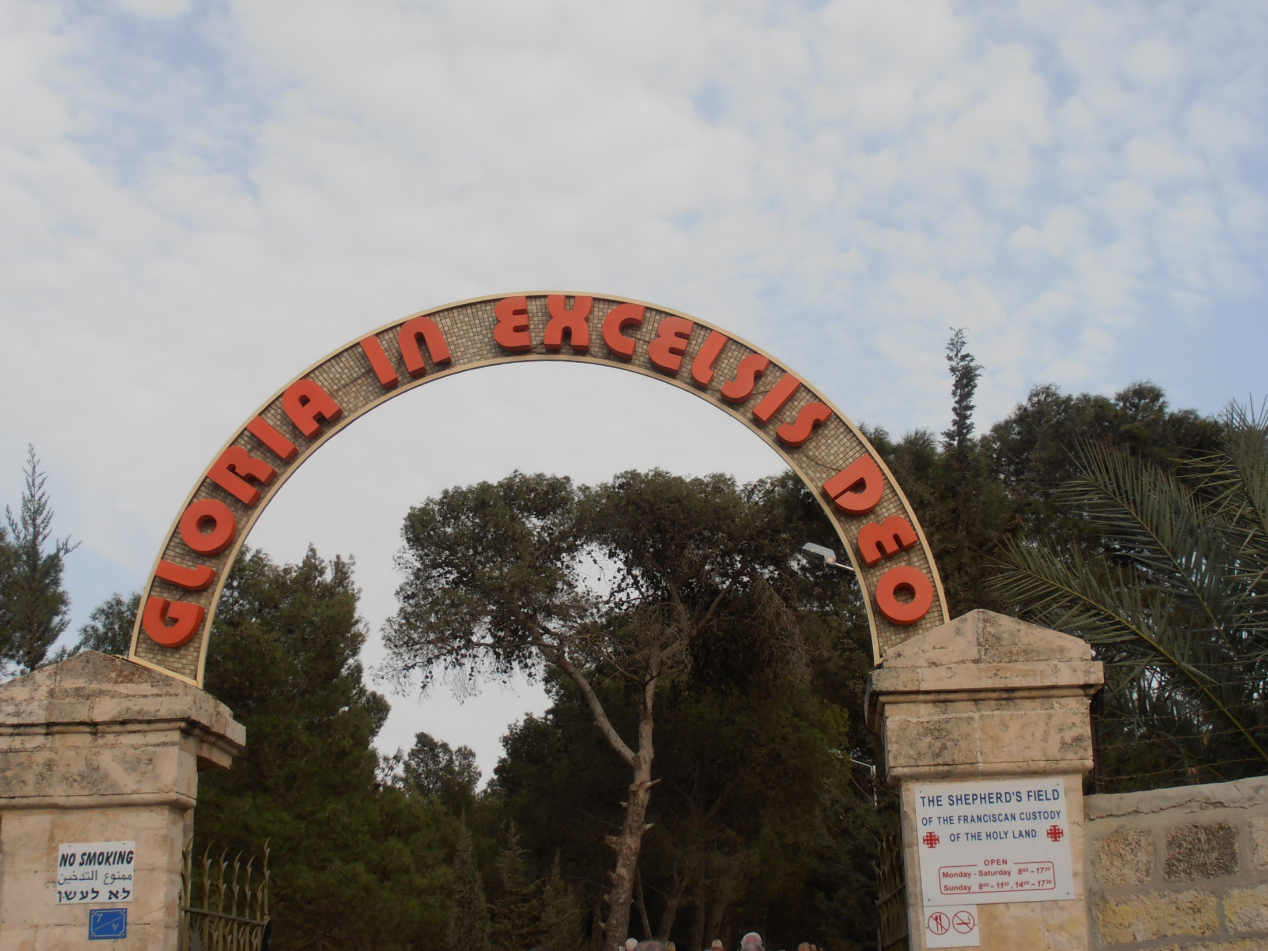

Slide 3
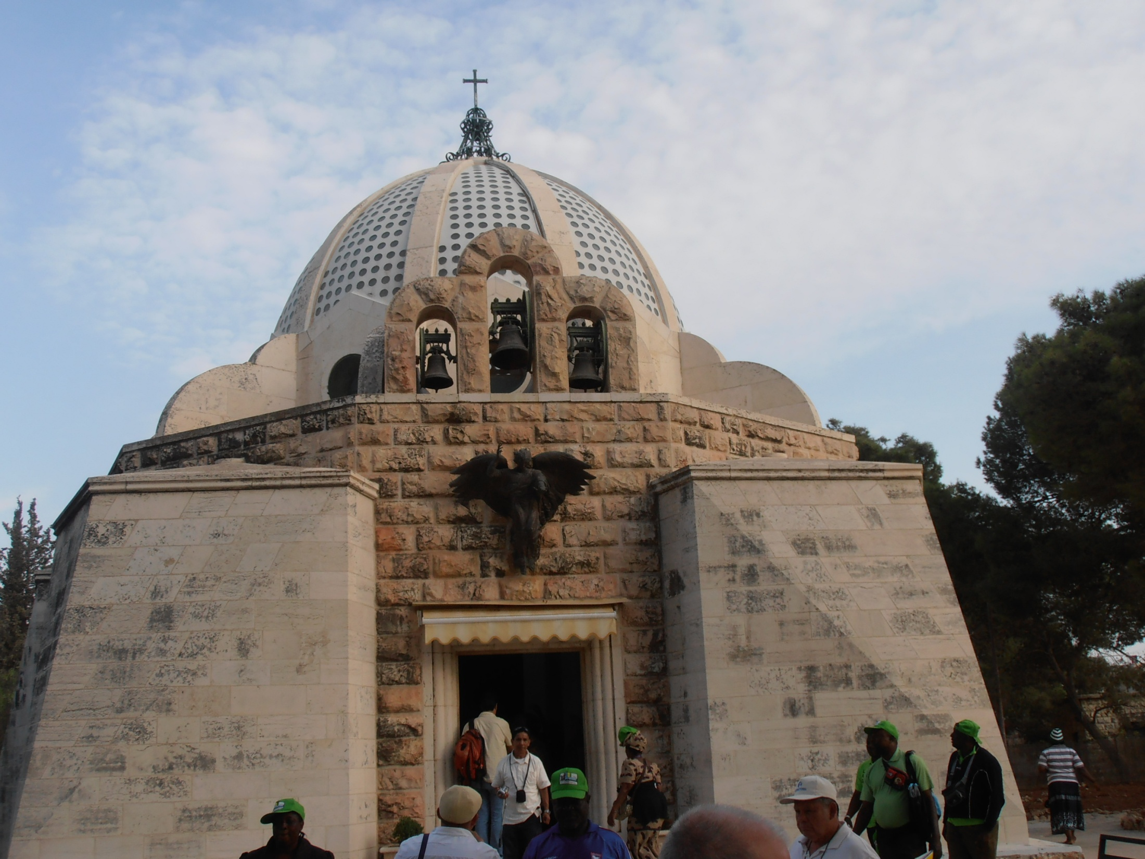

Slide 4
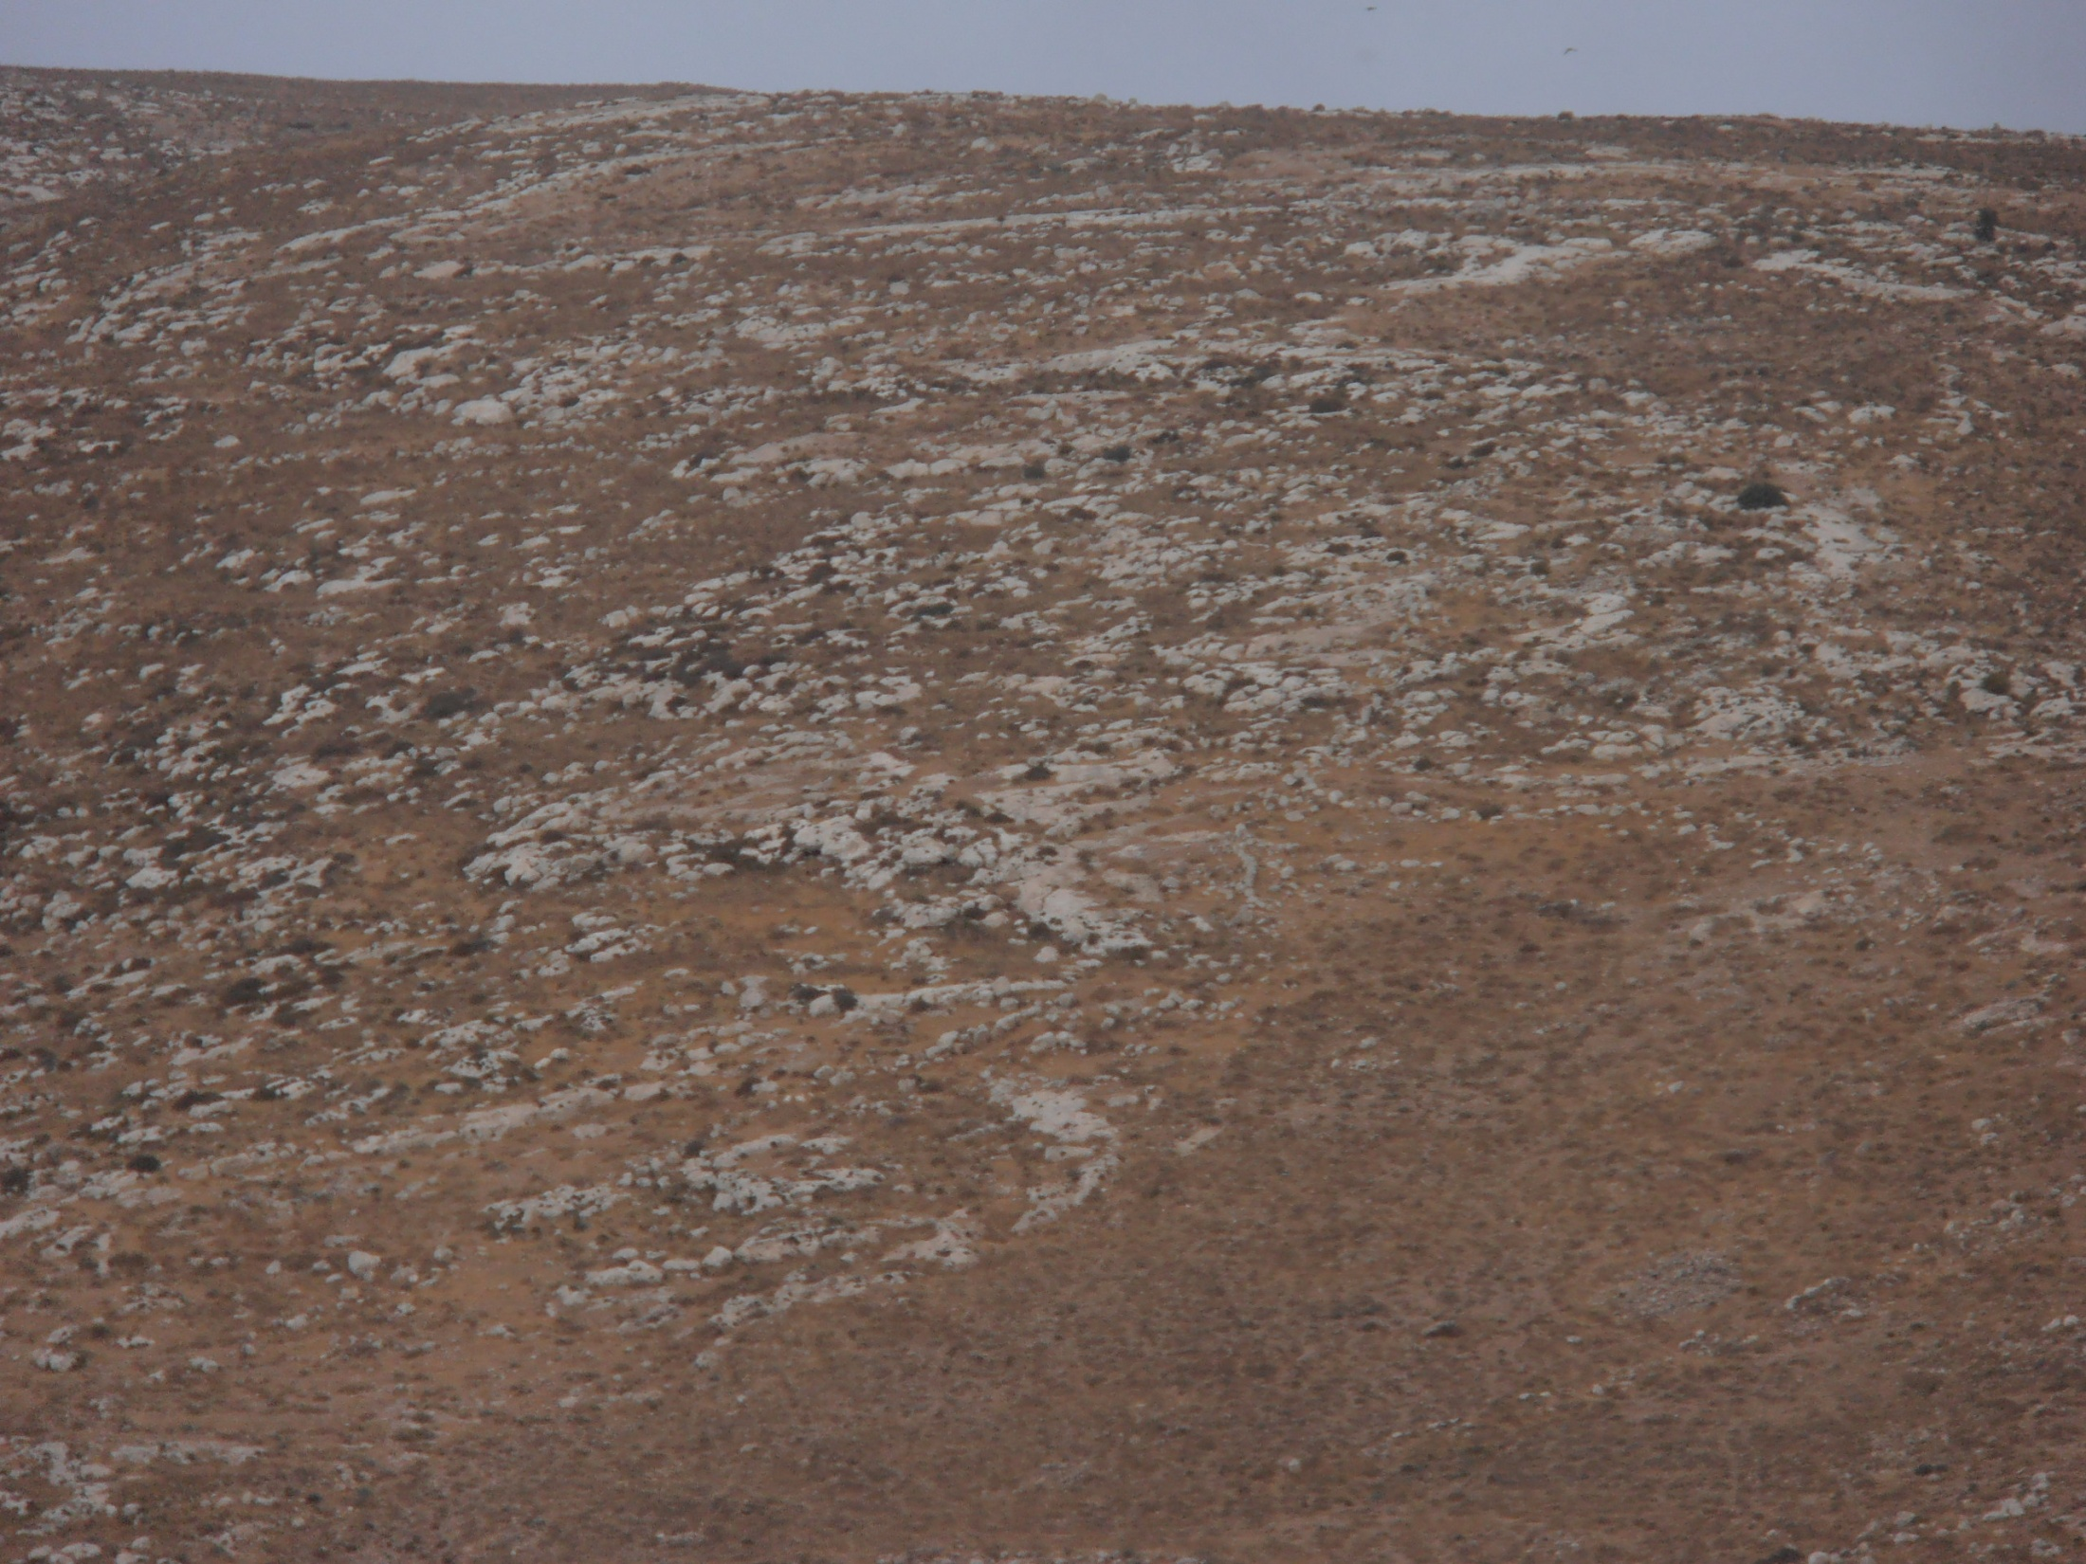

Slide 5
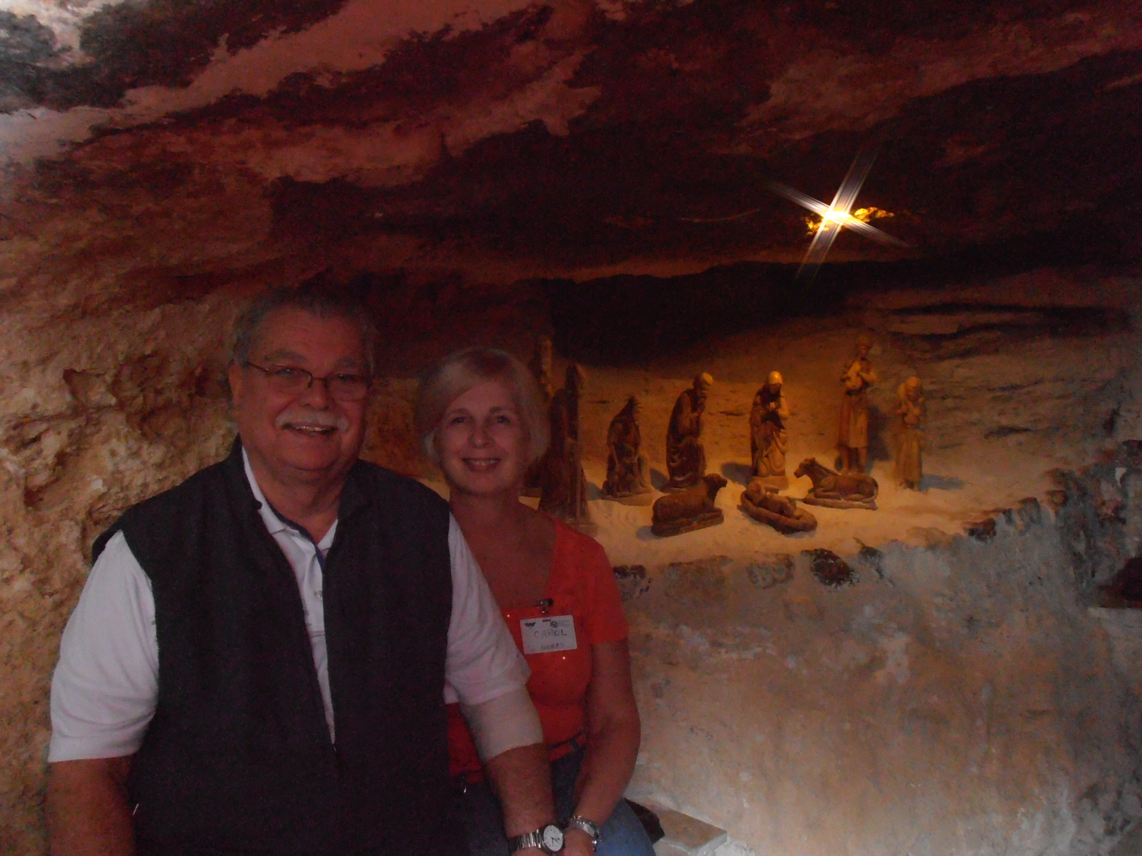

Slide 6
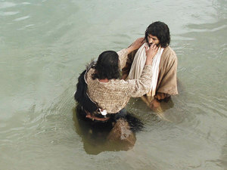
Then Jesus came from Galilee to the Jordan to be baptized by John.

Slide 7
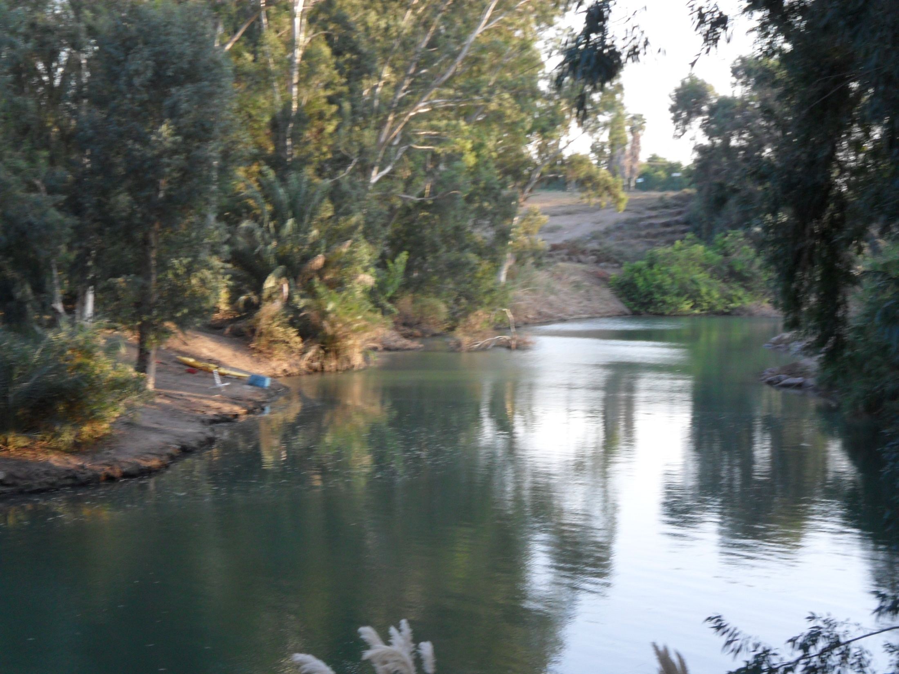

Slide 8
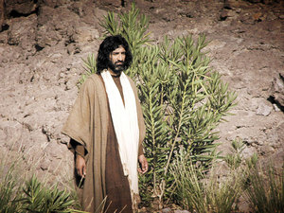
Then Jesus was led by the Spirit into the wilderness to be tempted by the devil.

Slide 9
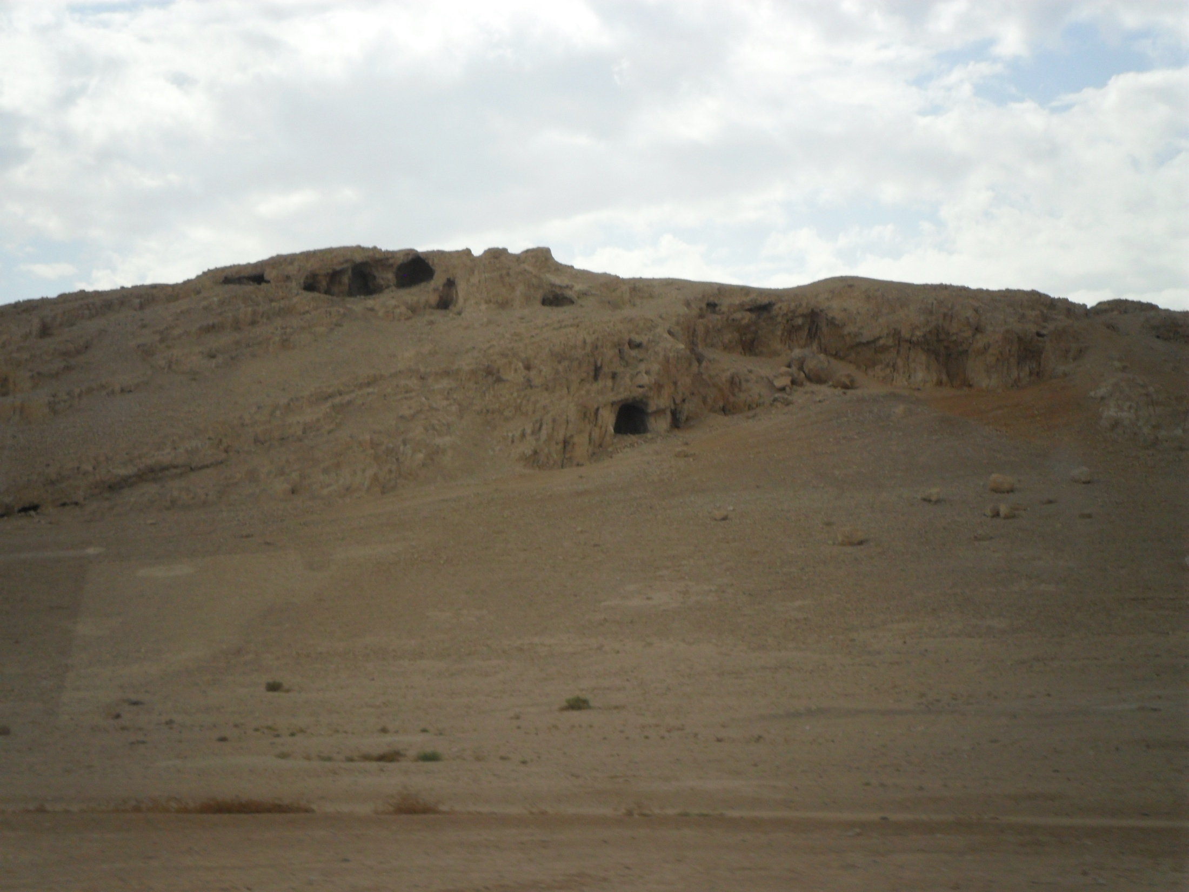

Slide 10
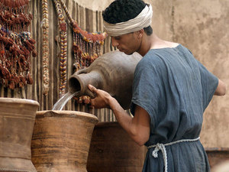
On the third day a wedding took place at Cana in Galilee. Jesus’ mother was there, and Jesus and his disciples had also been invited to the wedding. When the wine was gone, Jesus’ mother said to him, “They have no more wine.”
Nearby stood six stone water jars, the kind used by the Jews for ceremonial washing, each holding from twenty to thirty gallons.
Jesus said to the servants, “Fill the jars with water”; so they filled them to the brim.
They did so, and the master of the banquet tasted the water that had been turned into wine. He did not realize where it had come from, though the servants who had drawn the water knew. Then he called the bridegroom aside and said, “Everyone brings out the choice wine first and then the cheaper wine after the guests have had too much to drink; but you have saved the best till now.”

Slide 11
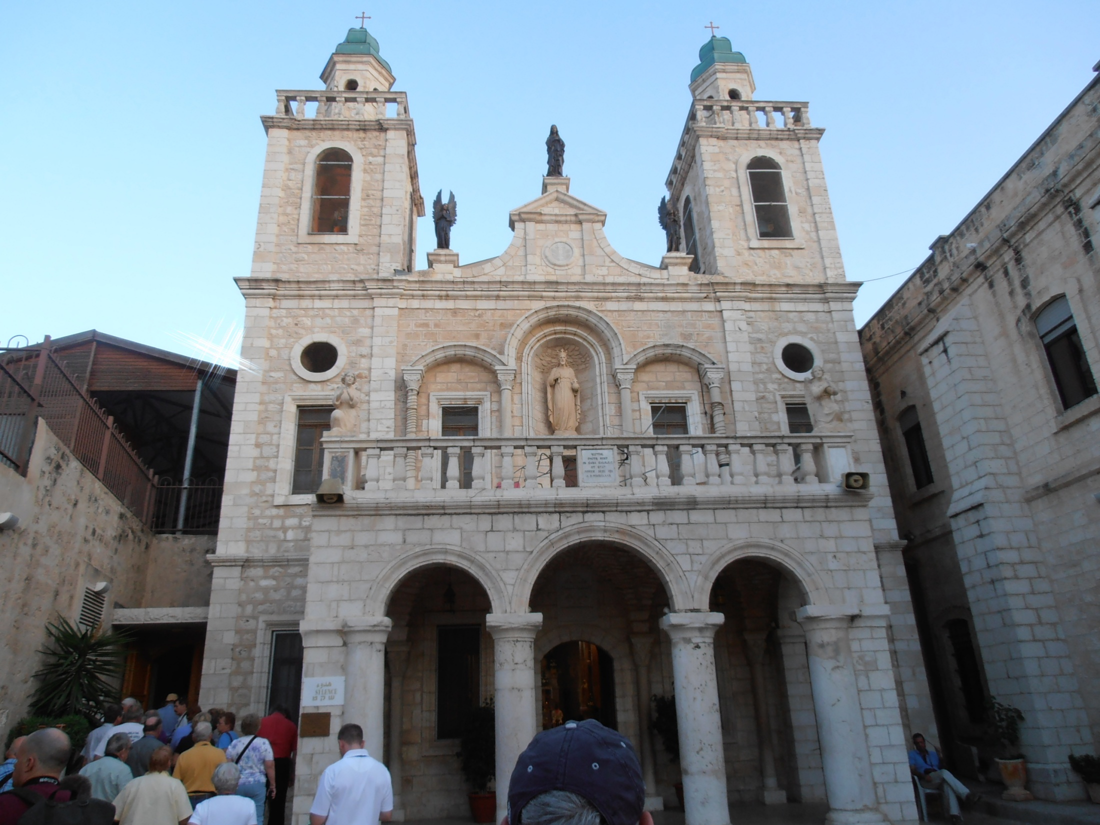

Slide 12
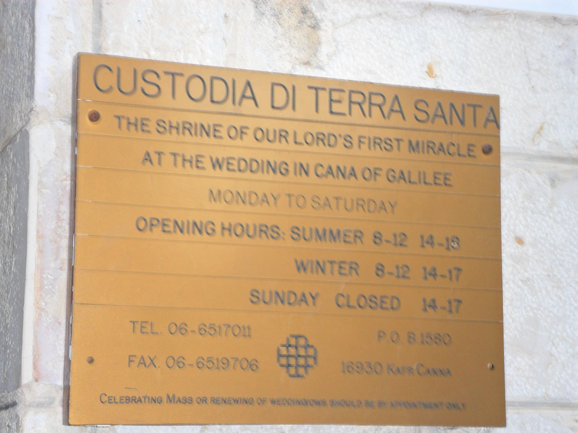

Slide 13
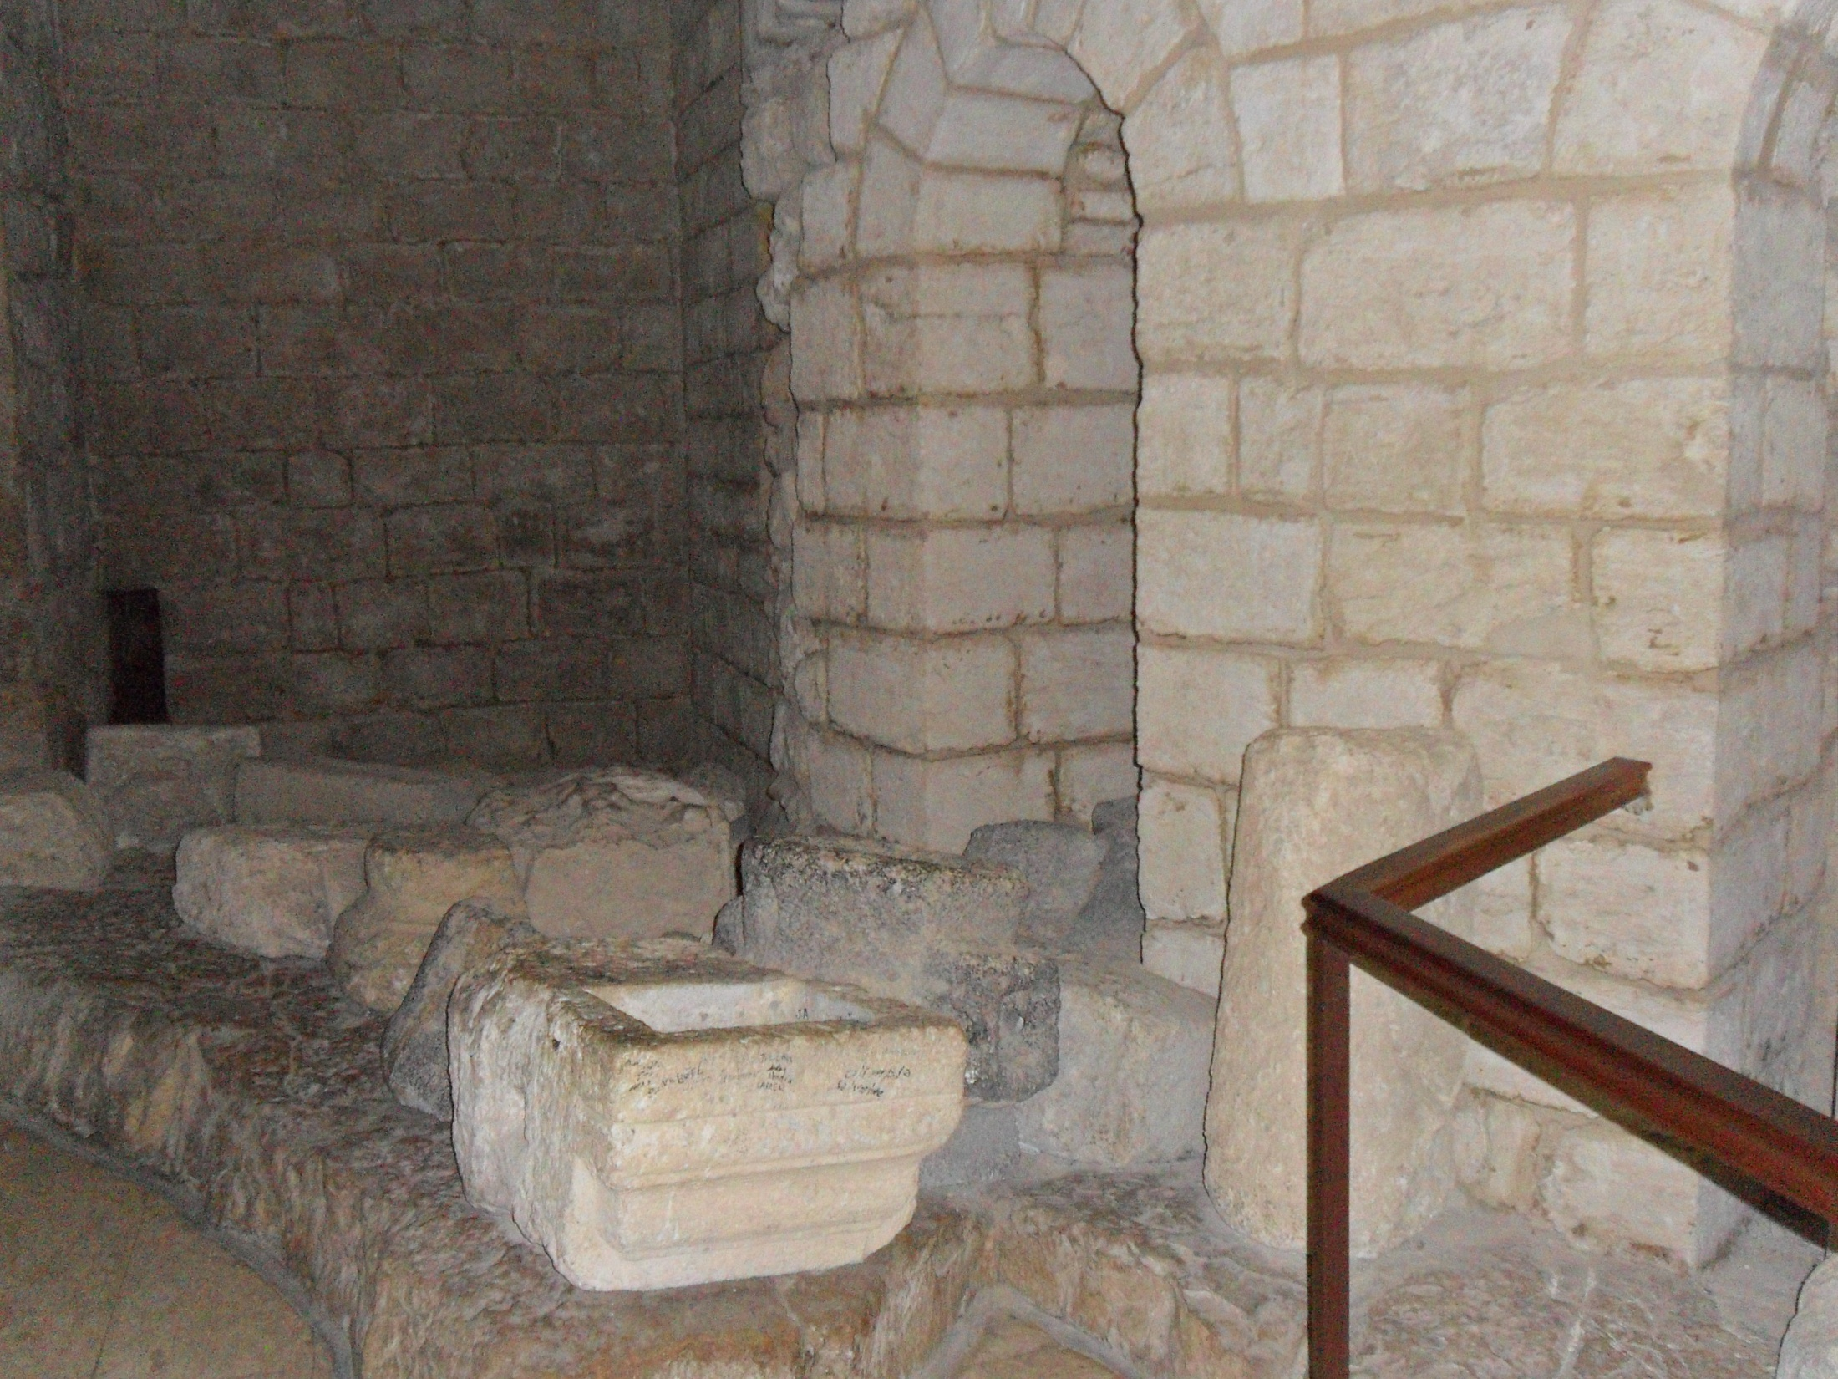

Slide 14
